Slide 1
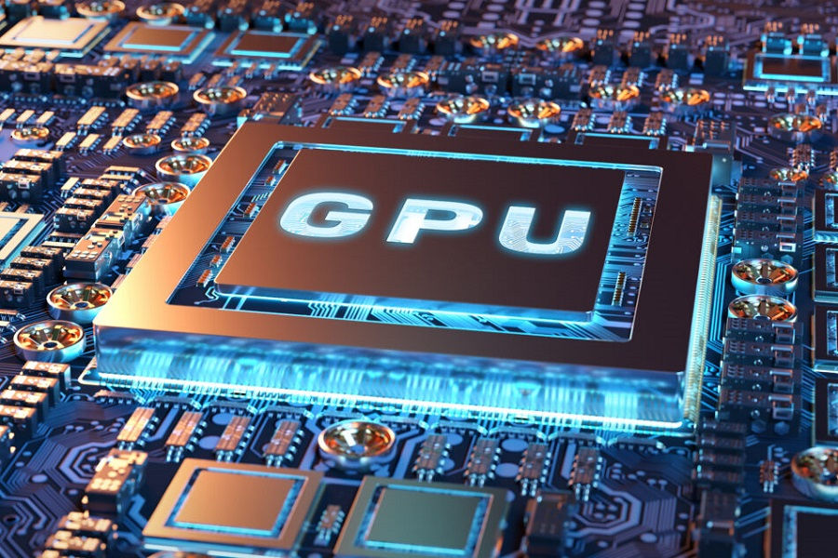
Gpu architecture
By: Radwa Sadek, Charlotte Saethre, Nikolas Jones, and Samuel Gardner​

Slide 2
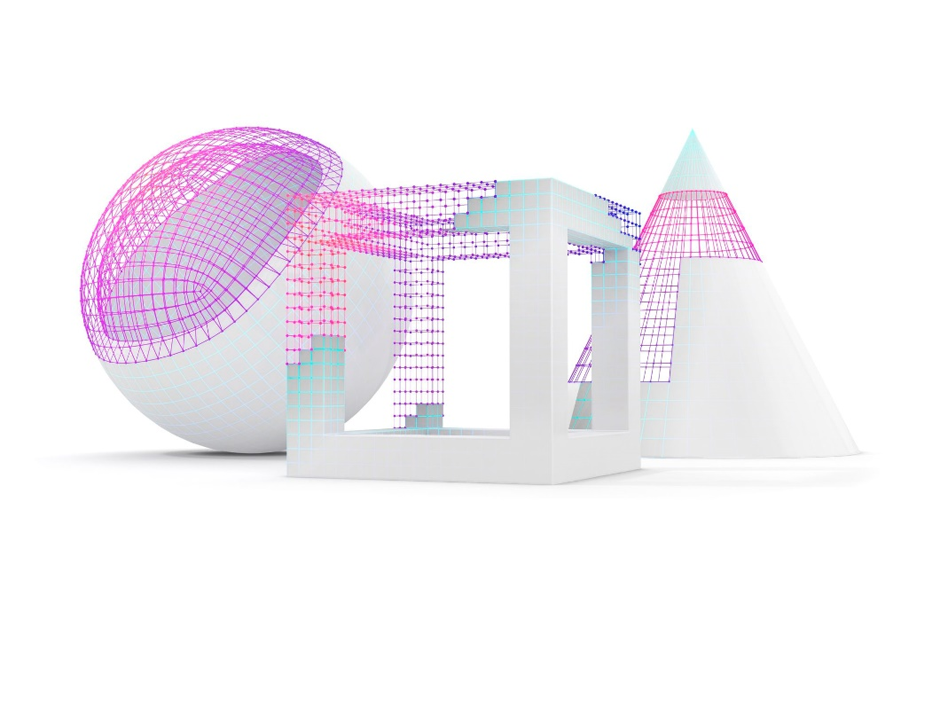
Table of Contents
Introduction
CPU vs GPU
GPU Architecture
Graphics Pipeline
Applications
NVIDIA
Future of GPUs
Conclusion
References

Slide 3
Introduction
A Graphical Processing Unit or GPU is a computer chip or electronic circuit that can perform mathematical calculations rapidly.
GPU’s are known for parallel machine processing.
Today GPU technology plays an important role in the scientific community.

Slide 4
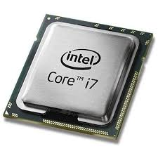
CPU vs GPU
A CPU can be considered a “jack-of-all-trades” for computation.
CPUs commonly have 4 to 16 cores while GPUs a much higher core count.
GPUs focus on parallelizing workloads, which means to split a job up into small manageable pieces that each core can handle.
A GPUs memory is typically smaller than a CPU because it is oriented towards bandwidth over latency.
However, GPUs ability to brute force a big workload can make it preferable for highly demanding computations.

Slide 5
How the GPU Architecture works
Understanding how the GPU architecture works leads us to the Graphics Pipeline.
The overall process involves getting input as a list of mesh data, in the form of vertices and edges. This 3D mesh data gets transformed into 4x4 worldspace matrix data.
The matrices representing the mesh data get shaded and mapped onto the screen to assemble what makes up the final image that you see.

Slide 6

The Graphics Pipeline
Stage 1 – Vertex Operation Stage:
Receiving primitives as input and forming the individual vertices.
Computing the vertices interaction with the lights in the scene transforms the vertices onto screen space.
This stage is good for parallel hardware.

Slide 7

The Graphics Pipeline
Stage 2 – Primitive Assembly:
Vertices get assembled into their triangles.

Slide 8
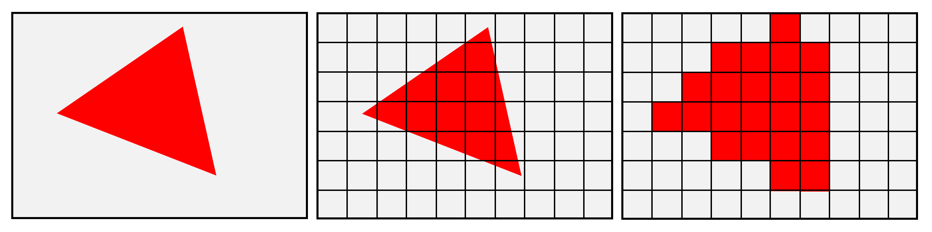
The Graphics Pipeline
Stage 3 – Rasterization:
This stage involves generating another primitive called a fragment.
During this stage it is determined what triangle covers what screen space pixel location in the scene.
Sometimes, anti-aliasing is involved in this process, where after the last step the graphics card can “fuzz” the edge to simulate a more granular line (when viewed from far enough away that pixels cannot be distinguished).

Slide 9
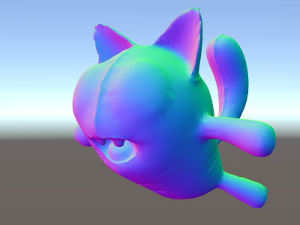
The Graphics Pipeline
Stage 4 – Fragment Operation:
Each fragment is shaded into the final color. Color is determined by information from vertices typically.
This is a stage to be computed in parallel.
Computationally demanding stage.
The colors you’re seeing on this 3D model is called a “normal map”, where each color component (red, green, and blue) represent a component of a normalized vector, where that vector represents the direction a given pixel is “facing away” from the model. The same way that a depth buffer is useful in the rendering process, a normal map is useful for shading.

Slide 10
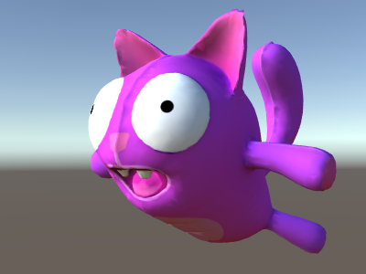
The Graphics Pipeline
Stage 5- Composition:
Fragments assembled into the final image with one color per pixel.

Slide 11
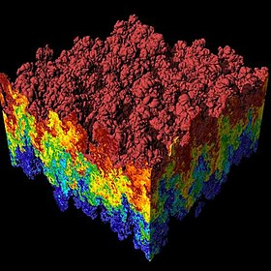

Applications
Algorithms such as differential equations and linear algebra enable applications such as databases, data mining and scientific simulations.
Fluid dynamics, heat transfer, rigid body physics for game development, and molecular dynamics are good examples of what the GPU can be best utilized for.

Slide 12

NVIDIA
Founded April 5, 1993 by Jensen Huang, Chris Malachowsky, and Curtis Priem
Makes GPU chips, smartphone, and automotive chips.
They believed the future of computing lied within graphics-based computing. Instead of normal general-purpose computing.
Well known for their series of GPU's named as "GeForce".

Slide 13

The Future of GPUs
Integrated and hybrid GPUs are in constant development and will replace GPUs in applications dedicated to artificial intelligence.
Portable electronics such as wearables will continue to grow in popularity along with IoT driving the growth of the GPU market.
The GPU market is expected to reach $200.85 billion by 2027.

Slide 14
Conclusion
GPUs are applied to several applications that drive scientific innovations.
GPUs use parallelism to accomplish highly demanding computational tasks.
GPUs have a higher core count than CPUs and can handle more complex computations than the average CPU.
The graphics pipeline is key to understanding how the GPU architecture works.
GPUs will play an important role as we become more interconnected with IoT technologies in society.

Slide 15
References
Rachita Rake; “Graphic Processing Unit (GPU) Market by Type (Dedicated, Integrated, and Hybrid), Device (Computer, Tablet, Smartphone, Gaming Console, Television, and Others), Industry Vertical (Electronics, IT & Telecommunication, Defense & Intelligence, Media & Entertainment, and Others)”: Global Opportunity Analysis and Industry Forecast, 2020-2027, SE : Electronic Systems and Devices, . A01470, Page 266, June 2020.
https://www.intel.com/content/www/us/en/products/docs/processors/cpu-vs-gpu.html
AndersEklundª et al, “Medical image processing on the GPU – Past, present and future”, Medical Image Analysis, Volume 17, Issue 8, December 2013, Pages 1073-1094.
Patterson, D. A., & Hennessy, J. L. (2014). Computer organization and design. the hardware/software interface. Boston, MA: Morgan Kaufmann.
Owens, J. D., Houston, M., Luebke, D., Green, S., Stone, J. E., & Phillips, J. C. (2008, May 5). GPU Computing. Retrieved November 22, 2020, from http://dmkd.cs.vt.edu/TUTORIAL/Bigdata/Papers/IEEE08.pdf
(Techquickie, 2016) https://youtu.be/1kypaBjJ-pg

